Slide 1





Programming and Coding Skills
Notes:
Programming languages are absolutely needed to establish effective communication with computers. In this module we will learn about these languages.

Slide 2
Disclaimer
The content is curated from online/offline resources and used for educational purpose only

Slide 3

Learning Objectives
Core JAVA (J2SE) Programming and Coding Skills
Notes:
The learning objectives of this presentation is as follows:
Core JAVA (J2SE) Programming and Coding Skills

Slide 4





Scenario
Source:
https://www.freepngimg.com/thumb/android/58538-development-android-software-free-hd-image.png
https://1000marken.net/wp-content/uploads/2021/01/Minecraft-Symbol.png
th (397×265) (bing.com)
Notes:
Students, I am sure that many of you use Android mobile phones.
some of you might have played Minecraft or have you used LibreOffice to develop your reports presentations and even spreadsheets.
common element in all the mentioned software is Java.
https://www.freepngimg.com/thumb/android/58538-development-android-software-free-hd-image.png
https://1000marken.net/wp-content/uploads/2021/01/Minecraft-Symbol.png
th (397×265) (bing.com)

Slide 5

Contents​
Introduction to JAVA Programming
Java Fundamentals
Java Control Statements
Java Arrays
Java Class and Objects
Important Topics of OOPS Concept
Java Exception Handling
Additional Topics
Source:
https://www.freepik.com/premium-vector/content-marketing-landing-page_6324893.htm#
Notes:
Our contents for the following session is our discussion on:
Introduction to JAVA Programming
Java Fundamentals
Java Control Statements
Java Arrays
Java Class and Objects
Important Topics of OOPS Concept
Java Exception Handling
Additional Topics

Slide 6

Introduction
After 27 years of existence, Java is still doing well.
Programmers who know it are still in high demand.
They will continue to be sought after for a long time to come as over 90% of the Fortune 500 companies still rely on Java for their development projects.
Source:
https://dev.to/tech_sam/let-s-revisit-java-in-2019-3o8c
Notes:
As the world moves more towards mobile apps and convenience, Java is becoming more and more instrumental as a language. It’s one of the strongest languages we see, ranked third most popular with recruiters in the last two years.
After 27 years of existence, Java is still doing well.
Programmers who know it are still in high demand.
They will continue to be sought after for a long time to come as over 90% of the Fortune 500 companies still rely on Java for their development projects.
Reference - https://www.codingdojo.com/blog/should-i-learn-java#:~:text=Are%20you%20wondering%20if%20you,in%20the%20last%20two%20years

Slide 7
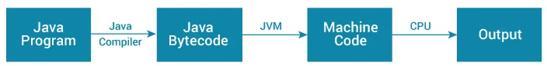
Java JDK, JRE and JVM
What is JVM?
JVM (Java Virtual Machine) is an abstract machine that enables your computer to run a Java program.
Working of Java Program
Source:
https://www.programiz.com/java-programming/jvm-jre-jdk
Notes:
What is JVM?
JVM (Java Virtual Machine) is an abstract machine that enables your computer to run a Java program.
When you run the Java program, Java compiler first compiles your Java code to bytecode. Then, the JVM translates bytecode into native machine code (set of instructions that a computer's CPU executes directly).
Java is a platform-independent language. It's because when you write Java code, it's ultimately written for JVM but not your physical machine (computer). Since JVM ​executes the Java bytecode which is platform-independent, Java is platform-independent.
Reference - https://www.programiz.com/java-programming/jvm-jre-jdk

Slide 8
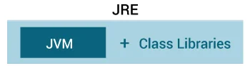
Java JDK, JRE and JVM
What is JRE?
JRE (Java Runtime Environment) is a software package.
It provides Java class libraries, Java Virtual Machine (JVM), and other components that are required to run Java applications.
Java Runtime Environment
Source:
https://www.programiz.com/java-programming/jvm-jre-jdk
Notes:
What is JRE?
JRE (Java Runtime Environment) is a software package that provides Java class libraries, Java Virtual Machine (JVM), and other components that are required to run Java applications.
JRE is the superset of JVM.
If you need to run Java programs, but not develop them, JRE is what you need.
Reference - https://www.programiz.com/java-programming/jvm-jre-jdk

Slide 9
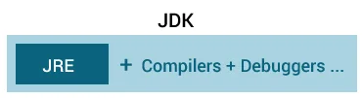
Java JDK, JRE and JVM
What is JDK?
JDK (Java Development Kit) is a software development kit required to develop applications in Java.
Java Development Kit
Source:
https://www.programiz.com/java-programming/jvm-jre-jdk
Notes:
Java JDK, JRE and JVM
What is JDK?
JDK (Java Development Kit) is a software development kit required to develop applications in Java.
When you download JDK, JRE is also downloaded with it.
In addition to JRE, JDK also contains a number of development tools (compilers, JavaDoc, Java Debugger, etc).
If you want to develop Java applications, download JDK.
Reference - https://www.programiz.com/java-programming/jvm-jre-jdk

Slide 10
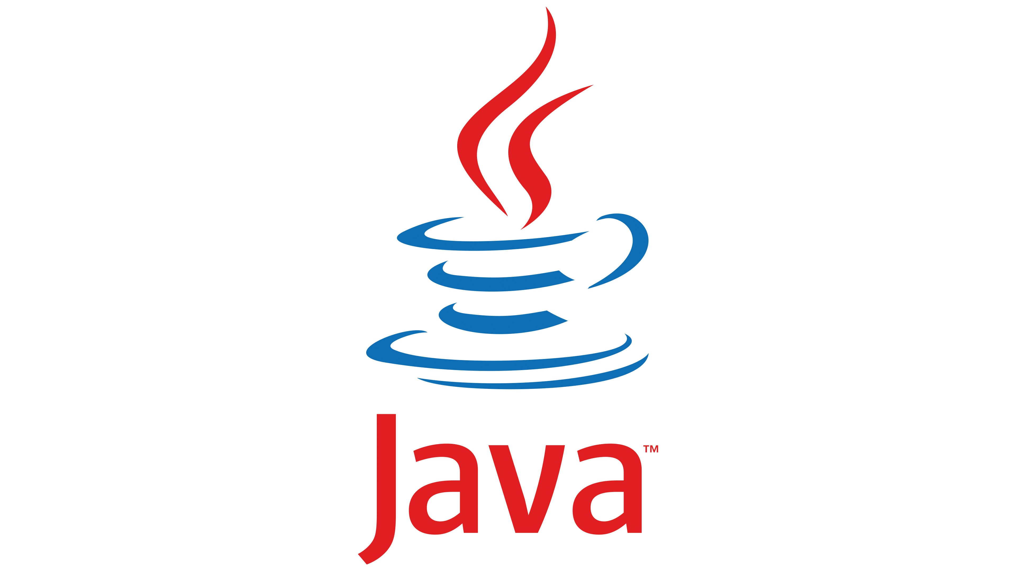
Java Variables
A variable is a location in memory (storage area) to hold data.
To indicate the storage area, each variable should be given a unique name (identifier).
Notes:
Java Variables
A variable is a location in memory (storage area) to hold data.
To indicate the storage area, each variable should be given a unique name (identifier).
Reference - https://www.programiz.com/java-programming

Slide 11
Java Data Types
Data types specify the type of data that can be stored inside variables in Java.
There are 8 Primitive Data Types:
Boolean
Byte
Short
Int
Long
Double
Float
Char
Notes:
Java Data Types
Data types specify the type of data that can be stored inside variables in Java.
Java is a statically-typed language. This means that all variables must be declared before they can be used.
There are 8 Primitive Data Types:
1. boolean type
The boolean data type has two possible values, either true or false.
Default value: false.
They are usually used for true/false conditions.
2. byte type
The byte data type can have values from -128 to 127 (8-bit signed two's complement integer).
If it's certain that the value of a variable will be within -128 to 127, then it is used instead of int to save memory.
Default value: 0
3. short type
The short data type in Java can have values from -32768 to 32767 (16-bit signed two's complement integer).
If it's certain that the value of a variable will be within -32768 and 32767, then it is used instead of other integer data types (int, long).
Default value: 0
4. int type
The int data type can have values from -2³¹ to 2³¹-1 (32-bit signed two's complement integer).
If you are using Java 8 or later, you can use an unsigned 32-bit integer. This will have a minimum value of 0 and a maximum value of 2³²-1.
Default value: 0
5. long type
The long data type can have values from -2⁶³ to 2⁶³-1 (64-bit signed two's complement integer).
If you are using Java 8 or later, you can use an unsigned 64-bit integer with a minimum value of 0 and a maximum value of 2⁶⁴-1.
Default value: 0
6. double type
The double data type is a double-precision 64-bit floating-point.
It should never be used for precise values such as currency.
Default value: 0.0 (0.0d)
7. float type
The float data type is a single-precision 32-bit floating-point.
It should never be used for precise values such as currency.
Default value: 0.0 (0.0f)
8. char type
It's a 16-bit Unicode character.
The minimum value of the char data type is '\u0000' (0) and the maximum value of the is '\uffff'.
Default value: '\u0000'
Reference - https://www.programiz.com/java-programming

Slide 12
Java Operators
Operators are symbols that perform operations on variables and values.
Here are some commonly used Java operators along with examples:
Arithmetic Operators
Assignment Operators
Comparison Operators
Logical Operators
Unary Operators
Increment and Decrement Operators
Conditional (Ternary) Operator
Notes:
Java operators are symbols that perform various operations on operands (variables, values, expressions). They are used to manipulate data, perform calculations, and make comparisons. Here are some commonly used Java operators along with examples:
1. **Arithmetic Operators:**
These operators perform basic mathematical operations.
```java
int a = 10, b = 5;
int sum = a + b; // Addition
int difference = a - b; // Subtraction
int product = a * b; // Multiplication
int quotient = a / b; // Division
int remainder = a % b; // Modulus (remainder)
```
2. **Assignment Operators:**
These operators are used to assign values to variables.
```java
int x = 10;
x += 5; // Equivalent to x = x + 5
x -= 3; // Equivalent to x = x - 3
x *= 2; // Equivalent to x = x * 2
x /= 4; // Equivalent to x = x / 4
```
3. **Comparison Operators:**
These operators compare two values and return a boolean result.
```java
int p = 7, q = 7;
boolean isEqual = p == q; // Equal to
boolean isNotEqual = p != q; // Not equal to
boolean isGreaterThan = p > q; // Greater than
boolean isLessThan = p < q; // Less than
boolean isGreaterOrEqual = p >= q; // Greater than or equal to
boolean isLessOrEqual = p <= q; // Less than or equal to
```
4. **Logical Operators:**
These operators perform logical operations on boolean values.
```java
boolean bool1 = true, bool2 = false;
boolean logicalAnd = bool1 && bool2; // Logical AND
boolean logicalOr = bool1 || bool2; // Logical OR
boolean logicalNot = !bool1; // Logical NOT
```
5. **Unary Operators:**
These operators work with a single operand.
```java
int num = 5;
int positive = +num; // Unary plus (no effect)
int negative = -num; // Unary minus (negation)
boolean isTrue = true;
boolean notTrue = !isTrue; // Logical NOT
```
6. **Increment and Decrement Operators:**
These operators increase or decrease the value of a variable by 1.
```java
int count = 10;
count++; // Increment by 1
count--; // Decrement by 1
```
7. **Conditional (Ternary) Operator:**
This operator provides a concise way to express conditional operations.
```java
int num = 7;
String result = (num % 2 == 0) ? "Even" : "Odd";
```
These are just some of the fundamental operators in Java. Java also has bitwise operators, shift operators, instanceof operator, and more specialized operators for working with objects and arrays. Each operator serves a specific purpose in performing operations and making decisions in Java programs.

Slide 13

Lab 22: Installing Java and Writing a Hello World Program
Notes:
In this session, we will see how to install Java for development and write the first program.
***********Trainer should explain how to download and install JDK and how to write Hello World Program***********

Slide 14
Java Basic Input and Output
Java Output: In Java, we simply use
System.out.println(); or System.out.print(); or System.out.printf();
Java Input: Java provides different ways to get input from the user. One of them is by using object of Scanner class.
First, we need to import java.util.Scanner package.
Then, we need to create an object of the Scanner class.
We can use the object to take input from the user.
Notes:
Java Output
In Java, you can simply use
System.out.println(); or System.out.print(); or System.out.printf(); to send output to standard output (screen).
Here,
System is a class
out is a public static field: it accepts output data.
Difference between println(), print() and printf()
print() - It prints string inside the quotes.
println() - It prints string inside the quotes similar like print() method. Then the cursor moves to the beginning of the next line.
printf() - It provides string formatting (similar to printf in C/C++ programming).
Java Input
Java provides different ways to get input from the user.
One of them is by using object of Scanner class.
First, we need to import java.util.Scanner package.
Then, we need to create an object of the Scanner class.
We can use the object to take input from the user.
Reference - https://www.programiz.com/java-programming

Slide 15
Java Expressions, Statements and Blocks
Java Expressions: A Java expression consists of variables, operators, literals, and method calls.
Java Statements: In Java, each statement is a complete unit of execution.
Expression statements: We can convert an expression into a statement by terminating the expression with a.
Declaration Statements: In Java, declaration statements are used for declaring variables.
Java Blocks: A block is a group of statements (zero or more) that is enclosed in curly braces { }. A block may not have any statements.
Notes:
Java Expressions
A Java expression consists of variables, operators, literals, and method calls.
Java Statements
In Java, each statement is a complete unit of execution.
Expression statements
We can convert an expression into a statement by terminating the expression with a ;. These are known as expression statements.
Declaration Statements
In Java, declaration statements are used for declaring variables.
Java Blocks
A block is a group of statements (zero or more) that is enclosed in curly braces { }.
However, a block may not have any statements.
Reference - https://www.programiz.com/java-programming

Slide 16
Java Comments
Comments are a portion of the program that are completely ignored by Java compilers. They are mainly used to help programmers to understand the code.
In Java, there are two types of comments:
Single-line Comment: A single-line comment starts and ends in the same line. To write a single-line comment, we can use the // symbol.
Multi-line Comment: When we want to write comments in multiple lines, we can use the multi-line comment. To write multi-line comments, we can use the /*....*/ symbol.
Notes:
Java Comments
In computer programming, comments are a portion of the program that are completely ignored by Java compilers. They are mainly used to help programmers to understand the code.
Types of Comments in Java
In Java, there are two types of comments:
single-line comment
multi-line comment
Single-line Comment
A single-line comment starts and ends in the same line. To write a single-line comment, we can use the // symbol.
The Java compiler ignores everything from // to the end of line. Hence, it is also known as End of Line comment.
Multi-line Comment
When we want to write comments in multiple lines, we can use the multi-line comment. To write multi-line comments, we can use the /*....*/ symbol.
This type of comment is also known as Traditional Comment. In this type of comment, the Java compiler ignores everything from /* to */.
Use Comments the Right Way
One thing you should always consider that comments shouldn't be the substitute for a way to explain poorly written code in English. You should always write well structured and self explaining code. And, then use comments.
In most cases, always use comments to explain 'why' rather than 'how' and you are good to go.
Reference - https://www.programiz.com/java-programming

Slide 17
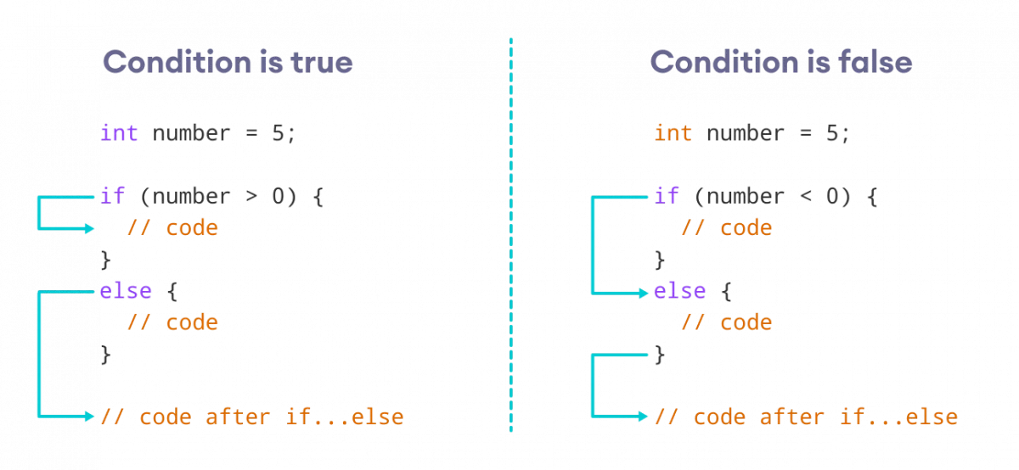
Java if...else Statement
We use the if..else statement to run a block of code among more than one alternative.
The if statement executes a certain section of code if the test expression is evaluated to true.
However, if the test expression is evaluated too false, it does nothing.
Statements inside the body of else block are executed if the test expression is evaluated too false.
How the if...else statement works?
Source:
https://www.programiz.com/java-programming/if-else-statement
Notes:
Java if...else Statement
In programming, we use the if..else statement to run a block of code among more than one alternatives.
For example, assigning grades (A, B, C) based on the percentage obtained by a student.
if the percentage is above 90, assign grade A
if the percentage is above 75, assign grade B
if the percentage is above 65, assign grade C
1. Java if (if-then) Statement
The syntax of an if-then statement is:
if (condition) {
// statements
}
Here, condition is a boolean expression such as age >= 18.
if condition evaluates to true, statements are executed
if condition evaluates to false, statements are skipped
2. Java if...else (if-then-else) Statement
The if statement executes a certain section of code if the test expression is evaluated to true. However, if the test expression is evaluated to false, it does nothing.
In this case, we can use an optional else block. Statements inside the body of else block are executed if the test expression is evaluated to false. This is known as the if-...else statement in Java.
Reference - https://www.programiz.com/java-programming

Slide 18
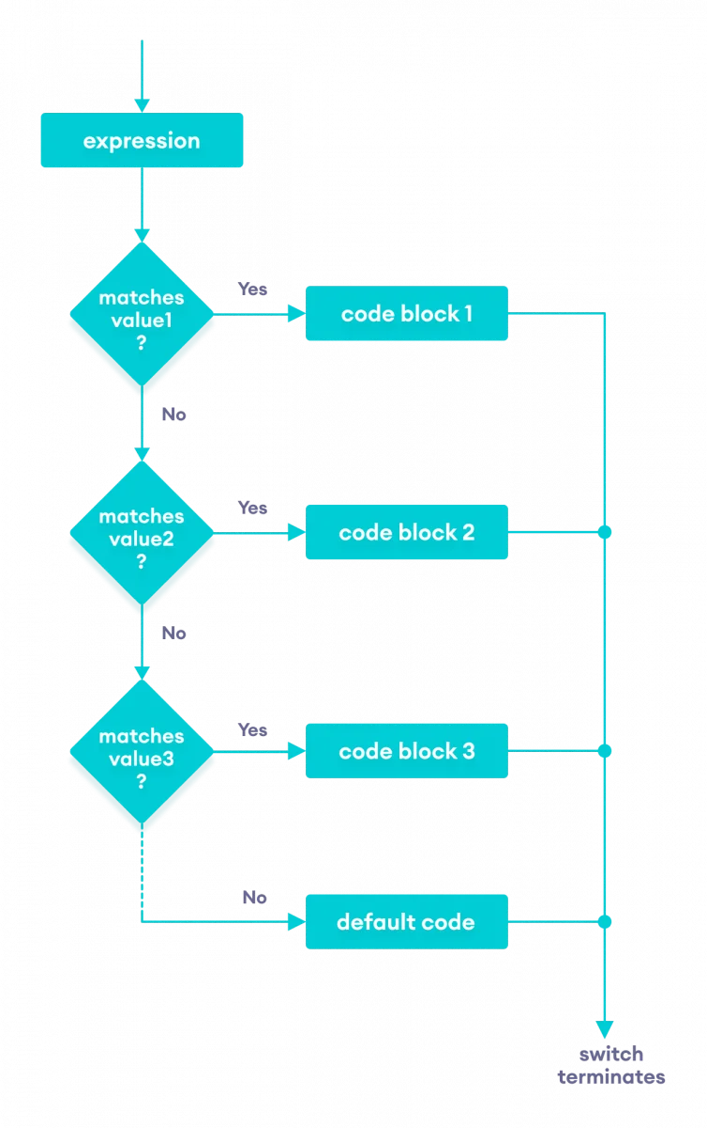
Java Switch Statement
The switch statement allows us to execute a block of code among many alternatives.
The expression is evaluated once and compared with the values of each case.
The working of the switch-case statement is like the Java if...else...if ladder.
However, the syntax of the switch statement is cleaner and much easier to read and write.
Flowchart of Switch Statement
Source:
https://www.programiz.com/java-programming/switch-statement
Notes:
Java switch Statement
The switch statement allows us to execute a block of code among many alternatives.
The syntax of the switch statement in Java is:
switch (expression) {
case value1:
// code
break;
case value2:
// code
break;
...
...
default:
// default statements
}
How does the switch-case statement work?
The expression is evaluated once and compared with the values of each case.
If expression matches with value1, the code of case value1 are executed. Similarly, the code of case value2 is executed if expression matches with value2.
If there is no match, the code of the default case is executed.
Note: The working of the switch-case statement is similar to the Java if...else...if ladder. However, the syntax of the switch statement is cleaner and much easier to read and write.
Reference - https://www.programiz.com/java-programming

Slide 19
Lab 23: Java Conditional Statements
Notes:
We have conditional statements in theory. Now, let’s use learned concepts into action. We will implement the different types of conditional statements.
********* Trainers should demonstrate if, if else, if elif else, switch case.*************

Slide 20
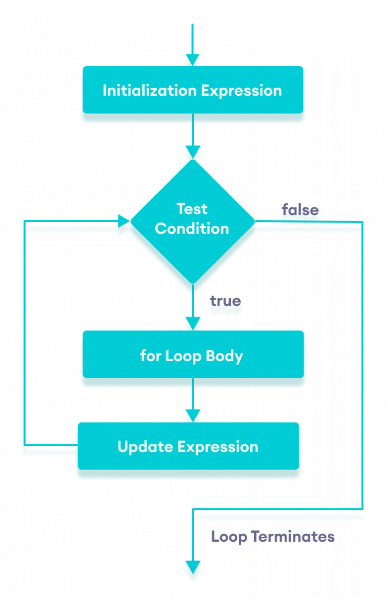
Java for Loop
In computer programming, loops are used to repeat a block of code.
Java for loop is used to run a block of code for a certain number of times.
Flowchart of Java for loop
Source:
https://www.programiz.com/java-programming/for-loop
Notes:
In computer programming, loops are used to repeat a block of code.
The Java for loop is used to run a block of code for a certain number of times.
Reference - https://www.programiz.com/java-programming

Slide 21
Java for-each Loop
In Java, the for-each loop is used to iterate through elements of arrays and collections (like ArrayList).
It is also known as the enhanced for loop.
The syntax of the Java for-each loop is:
for(dataType item : array) {
...
}
Notes:
Java for-each Loop
In Java, the for-each loop is used to iterate through elements of arrays and collections (like ArrayList). It is also known as the enhanced for loop.
for-each Loop Sytnax
The syntax of the Java for-each loop is:
for(dataType item : array) {
...
}
Here,
array - an array or a collection
item - each item of array/collection is assigned to this variable
dataType - the data type of the array/collection
Reference - https://www.programiz.com/java-programming

Slide 22
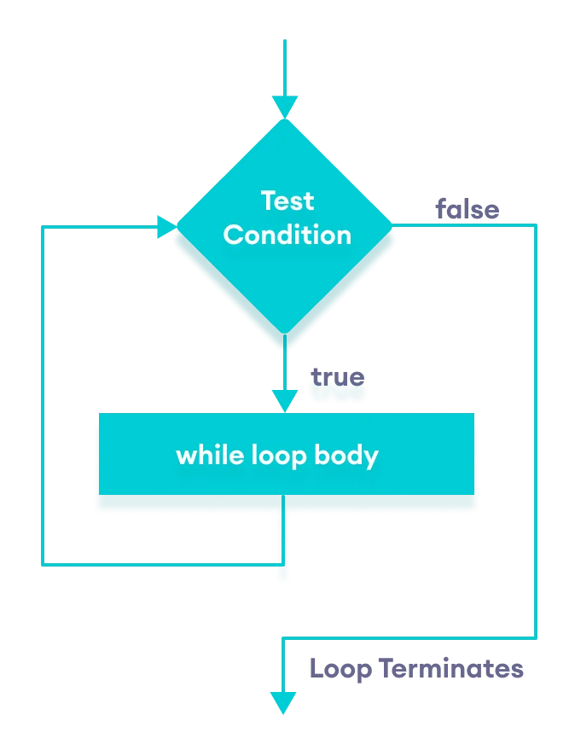
Java while Loop
Java while loop is used to run a specific code until a certain condition is met.
Flowchart of while loop
Source:
https://www.programiz.com/java-programming/do-while-loop
Notes:
Java while loop
Java while loop is used to run a specific code until a certain condition is met. The syntax of the while loop is:
while (testExpression) {
// body of loop
}
Here,
A while loop evaluates the textExpression inside the parenthesis ().
If the textExpression evaluates to true, the code inside the while loop is executed.
The textExpression is evaluated again.
This process continues until the textExpression is false.
When the textExpression evaluates to false, the loop stops.
Reference - https://www.programiz.com/java-programming

Slide 23
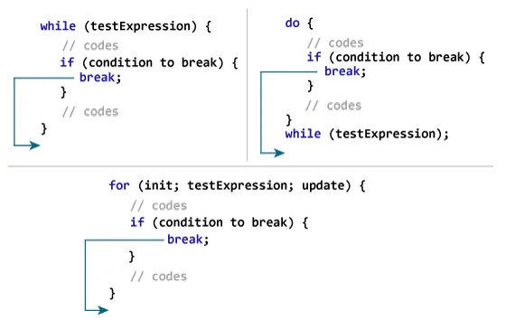
Java break Statement
While working with loops, it is sometimes desirable to skip some statements inside the loop or terminate the loop immediately without checking the test expression.
The break statement in Java terminates the loop immediately, and the control of the program moves to the next statement following the loop.
It is almost always used with decision-making statements (Java if...else Statement).
Working of Java break Statement
Source:
https://www.programiz.com/java-programming/break-statement
Notes:
Java break Statement
While working with loops, it is sometimes desirable to skip some statements inside the loop or terminate the loop immediately without checking the test expression.
In such cases, break and continue statements are used.
The break statement in Java terminates the loop immediately, and the control of the program moves to the next statement following the loop.
It is almost always used with decision-making statements (Java if...else Statement).
Reference - https://www.programiz.com/java-programming

Slide 24
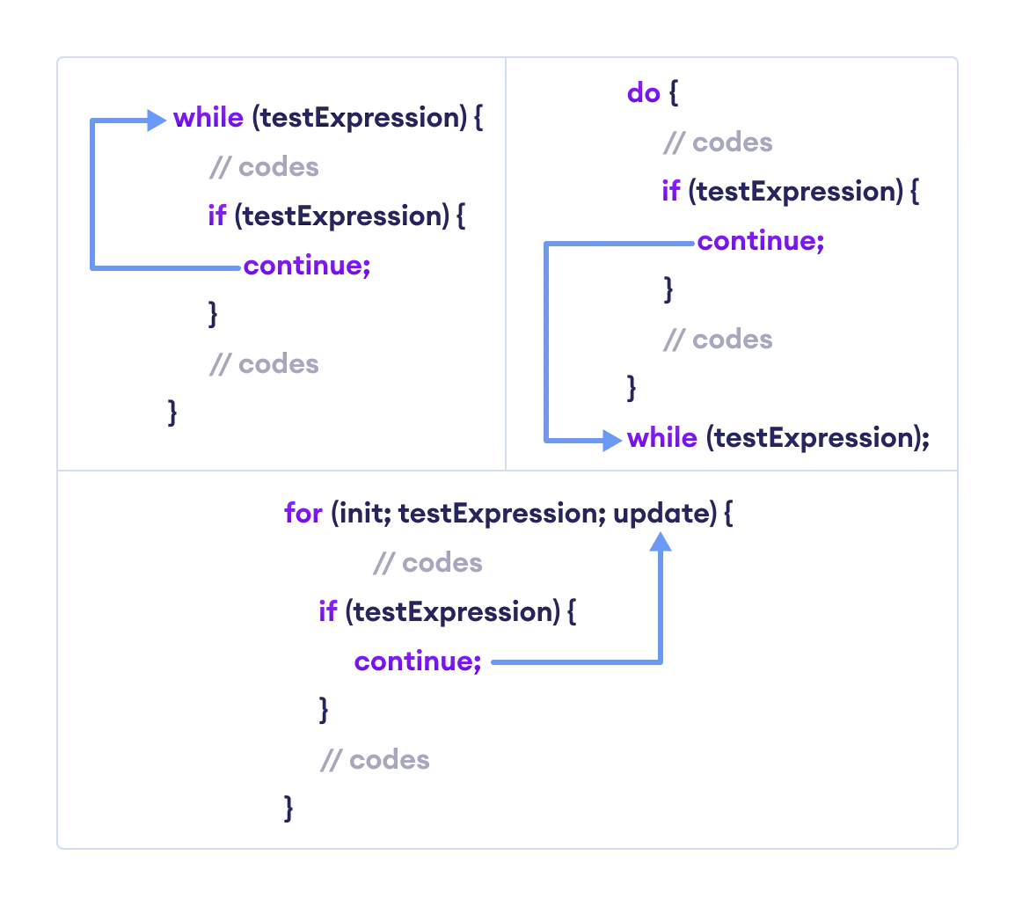
Java continue Statement
The continue statement skips the current iteration of a loop (for, while, do...while, etc).
After the continue statement, the program moves to the end of the loop.
And test expression is evaluated (update statement is evaluated in case of the for loop).
Working of Java continue Statement
Source:
https://www.programiz.com/java-programming/continue-statement
Notes:
Java continue Statement
The continue statement skips the current iteration of a loop (for, while, do...while, etc).
After the continue statement, the program moves to the end of the loop.
And, test expression is evaluated (update statement is evaluated in case of the for loop).
Reference - https://www.programiz.com/java-programming

Slide 25
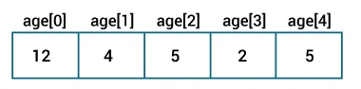
Java Arrays
An array is a collection of similar types of data.
Array indices always start from 0. That is, the first element of an array is at index 0.
If the size of an array is n, then the last element of the array will be at index n-1.
Java Arrays initialization
Source:
https://www.programiz.com/java-programming/arrays
Notes:
Java Arrays
An array is a collection of similar types of data.
For example, if we want to store the names of 100 people then we can create an array of the string type that can store 100 names.
String[] array = new String[100];
Here, the above array cannot store more than 100 names. The number of values in a Java array is always fixed.
How to declare an array in Java?
In Java, here is how we can declare an array.
dataType[] arrayName;
dataType - it can be primitive data types like int, char, double, byte, etc. or Java objects
arrayName - it is an identifier
How to Initialize Arrays in Java?
In Java, we can initialize arrays during declaration. For example,
//declare and initialize and array
int[] age = {12, 4, 5, 2, 5};
Here, we have created an array named age and initialized it with the values inside the curly brackets.
Note that we have not provided the size of the array. In this case, the Java compiler automatically specifies the size by counting the number of elements in the array (i.e. 5).
In the Java array, each memory location is associated with a number. The number is known as an array index. We can also initialize arrays in Java, using the index number.
Array indices always start from 0. That is, the first element of an array is at index 0.
If the size of an array is n, then the last element of the array will be at index n-1.
How to Access Elements of an Array in Java?
We can access the element of an array using the index number. Here is the syntax for accessing elements of an array,
// access array elements
array[index]
Reference - https://www.programiz.com/java-programming

Slide 26
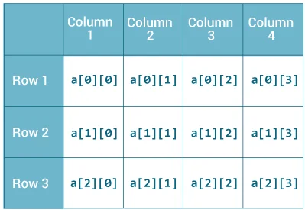
Java Multidimensional Arrays
A multidimensional array is an array of arrays.
Each element of a multidimensional array is an array itself.
Each element of the multidimensional array is an array itself.
unlike C/C++, each row of the multidimensional array in Java can be of different lengths.
2-dimensional Array
Source:
https://www.programiz.com/java-programming/multidimensional-array
Notes:
Java Multidimensional Arrays
A multidimensional array is an array of arrays. Each element of a multidimensional array is an array itself. For example,
int[][] a = new int[3][4];
Here, we have created a multidimensional array named a. It is a 2-dimensional array, that can hold a maximum of 12 elements.
How to initialize a 2d array in Java?
Here is how we can initialize a 2-dimensional array in Java.
int[][] a = {
{1, 2, 3},
{4, 5, 6, 9},
{7},
};
As we can see, each element of the multidimensional array is an array itself. And also, unlike C/C++, each row of the multidimensional array in Java can be of different lengths.
Reference - https://www.programiz.com/java-programming

Slide 27
Lab 24: Java Loop Statements
Notes:
Now let’s practice Loop statements. We will use for, while.
***************Trainer will demonstrate how to use Loop statements on an IDE**************

Slide 28
Java Class and Objects
Java Class
A class is a blueprint for the object. Before we create an object, we first need to define the class.
Java Objects
An object is called an instance of a class.
Notes:
Java Class and Objects
Java is an object-oriented programming language. The core concept of the object-oriented approach is to break complex problems into smaller objects.
An object is any entity that has a state and behavior. For example, a bicycle is an object. It has
States: idle, first gear, etc
Behaviors: braking, accelerating, etc.
Java Class
A class is a blueprint for the object. Before we create an object, we first need to define the class.
We can think of the class as a sketch (prototype) of a house. It contains all the details about the floors, doors, windows, etc. Based on these descriptions we build the house. House is the object.
Since many houses can be made from the same description, we can create many objects from a class.
Java Objects
An object is called an instance of a class. For example, suppose Bicycle is a class then MountainBicycle, SportsBicycle, TouringBicycle, etc can be considered as objects of the class.
Reference - https://www.programiz.com/java-programming

Slide 29
Java Methods
A method is a block of code that performs a specific task.
Dividing a complex problem into smaller chunks makes your program easy to understand and reusable.
In Java, there are two types of methods:
User-defined Methods
Standard Library Methods
Notes:
Java Methods
A method is a block of code that performs a specific task.
Dividing a complex problem into smaller chunks makes your program easy to understand and reusable.
In Java, there are two types of methods:
User-defined Methods: We can create our own method based on our requirements.
Standard Library Methods: These are built-in methods in Java that are available to use.
Standard Library Methods
The standard library methods are built-in methods in Java that are readily available for use. These standard libraries come along with the Java Class Library (JCL) in a Java archive (*.jar) file with JVM and JRE.
Reference - https://www.programiz.com/java-programming

Slide 30
Java Constructors
What is a Constructor?
A constructor in Java is like a method that is invoked when an object of the class is created.
Unlike Java methods, a constructor has the same name as that of the class and does not have any return type.
Notes:
Java Constructors
What is a Constructor?
A constructor in Java is similar to a method that is invoked when an object of the class is created.
Unlike Java methods, a constructor has the same name as that of the class and does not have any return type.
Reference - https://www.programiz.com/java-programming

Slide 31
Java Constructors
Types of Constructor
In Java, constructors can be divided into 3 types:
No-Arg Constructor
Parameterized Constructor
Default Constructor
Notes:
Types of Constructor
In Java, constructors can be divided into 3 types:
No-Arg Constructor
Parameterized Constructor
Default Constructor
1. Java No-Arg Constructors
Similar to methods, a Java constructor may or may not have any parameters (arguments).
If a constructor does not accept any parameters, it is known as a no-argument constructor.
2. Java Parameterized Constructor
A Java constructor can also accept one or more parameters. Such constructors are known as parameterized constructors (constructor with parameters).
3. Java Default Constructor
If we do not create any constructor, the Java compiler automatically create a no-arg constructor during the execution of the program. This constructor is called default constructor.
Reference - https://www.programiz.com/java-programming

Slide 32
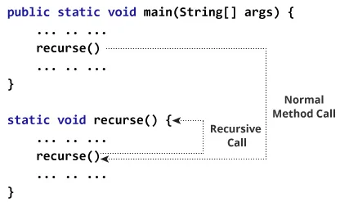
Java Recursion
A method that calls itself is known as a recursive method. And this process is known as recursion.
if...else statement is used to terminate the recursive call inside the method.
A recursive solution is much simpler and takes less time to write, debug and maintain.
Recursion generally uses more memory and is generally slow.
Working of Java Recursion
Source:
https://www.programiz.com/java-programming/recursion
Notes:
Java Recursion
A method that calls itself is known as a recursive method. And, this process is known as recursion.
if...else statement is used to terminate the recursive call inside the method.
When a recursive call is made, new storage locations for variables are allocated on the stack. As, each recursive call returns, the old variables and parameters are removed from the stack. Hence, recursion generally uses more memory and is generally slow.
On the other hand, a recursive solution is much simpler and takes less time to write, debug and maintain.
Reference - https://www.programiz.com/java-programming

Slide 33
Lab 25: Java Methods, Constructors and Recursion
Notes:
In this hands-on session, we will develop methods, constructors. We will see different varieties. We will also one of the most important concepts like recursion in action.
*******************trainer should explain methods, constructors and recursion in an IDE**********************

Slide 34
Java Strings
In Java, a string is a sequence of characters.
We use double quotes to represent a string in Java.
Strings in Java are not primitive types (like int, char, etc). Instead, all strings are objects of a predefined class named String.
All string variables are instances of the String class.
In Java, strings are immutable.
Notes:
Java Strings
In Java, a string is a sequence of characters. For example, "hello" is a string containing a sequence of characters 'h', 'e', 'l', 'l', and 'o'.
We use double quotes to represent a string in Java.
Strings in Java are not primitive types (like int, char, etc). Instead, all strings are objects of a predefined class named String.
And, all string variables are instances of the String class.
In Java, strings are immutable. This means, once we create a string, we cannot change that string.
Reference - https://www.programiz.com/java-programming

Slide 35
this Keyword
In Java, this keyword is used to refer to the current object inside a method or a constructor.
There are various situations where this keyword is commonly used:
Using this for ambiguity variable names
Using this in constructor overloading
Passing this as an argument
Notes:
this Keyword
In Java, this keyword is used to refer to the current object inside a method or a constructor.
There are various situations where this keyword is commonly used.
Using this for Ambiguity Variable Names
In Java, it is not allowed to declare two or more variables having the same name inside a scope (class scope or method scope). However, instance variables and parameters may have the same name.
Using this in Constructor Overloading
While working with constructor overloading , we might have to invoke one constructor from another constructor. In such a case, we cannot call the constructor explicitly. Instead, we have to use this keyword.
Passing this as an Argument
We can use this keyword to pass the current object as an argument to a method.
Reference - https://www.programiz.com/java-programming

Slide 36
Java final Keyword
In Java, the final keyword is used to denote constants. It can be used with variables, methods, and classes.
The final variable cannot be reinitialized with another value
The final method cannot be overridden
The final class cannot be extended
Notes:
Java final keyword
In Java, the final keyword is used to denote constants. It can be used with variables, methods, and classes.
Once any entity (variable, method or class) is declared final, it can be assigned only once. That is,
the final variable cannot be reinitialized with another value
the final method cannot be overridden
the final class cannot be extended
1. Java final Variable
In Java, we cannot change the value of a final variable.
2. Java final Method
In Java, the final method cannot be overridden by the child class.
3. Java final Class
In Java, the final class cannot be inherited by another class.
Reference - https://www.programiz.com/java-programming

Slide 37
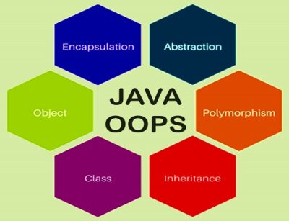
Understanding OOP concepts through core Java
OOP concepts include:
Inheritance
Polymorphism
Abstraction
Encapsulation
Source:
https://emergetech.org/tag/java/
Notes:
Understanding OOP concepts through core Java
Object-Oriented Programming is a paradigm that provides many concepts, such as inheritance, data binding, polymorphism, etc.
Simula is considered the first object-oriented programming language. The programming paradigm where everything is represented as an object is known as a truly object-oriented programming language.
Smalltalk is considered the first truly object-oriented programming language.
The popular object-oriented languages are Java, C#, PHP, Python, C++, etc.
The main aim of object-oriented programming is to implement real-world entities, for example, object, classes, abstraction, inheritance, polymorphism, etc.
Object means a real-world entity such as a pen, chair, table, computer, watch, etc. Object-Oriented Programming is a methodology or paradigm to design a program using classes and objects. It simplifies software development and maintenance by providing some concepts:
Object
Class
Inheritance
Polymorphism
Abstraction
Encapsulation
References - https://www.javatpoint.com/java-oops-concepts

Slide 38
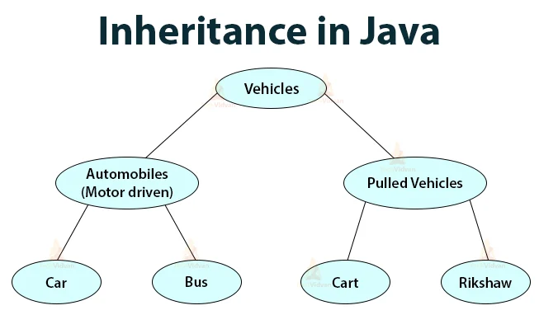
Inheritance
Inheritance lets programmers create new classes that share some of the attributes of existing classes.
Using Inheritance lets us build on previous work without reinventing the wheel.
Source:
https://techvidvan.com/tutorials/java-inheritance
Notes:
Inheritance in Java is a mechanism in which one object acquires all the properties and behaviors of a parent object. It is an important part of OOPs (Object Oriented programming system).
Look at the example on the screen or imagine you have a bunch of different animals, like cats, dogs, and birds. In Java, inheritance is like a family tree for these animals. Think of a main "Animal" class as the grandparent, which has general traits like "eat" and "move". Then, you have more specific classes like "Cat" and "Dog" that are like parents, inheriting the traits from "Animal" but also adding their own, like "meow" or "bark".
This helps save time and makes code neat. You don't need to rewrite "eat" and "move" for each animal; they already got it from the main "Animal" class. If you want to create a new animal, like a "Bird", you can make a new class that also inherits from "Animal". This way, the "Bird" gets all the basic traits automatically.
So, Java inheritance is like passing down traits from a family tree. It helps organize code and makes it easy to create new things that share similarities with existing things.
The idea behind inheritance in Java is that you can create new classes that are built upon existing classes. When you inherit from an existing class, you can reuse methods and fields of the parent class. Moreover, you can add new methods and fields in your current class also.

Slide 39
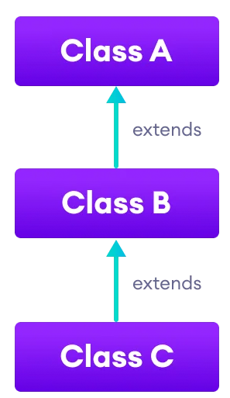
How Inheritance Works?
Inheritance lets a new class adopt the properties of another.
Inheriting class is called a subclass or a child class.
The original class is often called the parent.
Keyword extends is used to define a new class that inherits properties from an old class.
Source:
https://www.programiz.com/java-programming/inheritance
Notes:
Lets a new class adopt the properties of another.
Inheriting class is called a subclass or a child class.
The original class is often called the parent.
Keyword extends is used to define a new class that inherits properties from an old class.

Slide 40
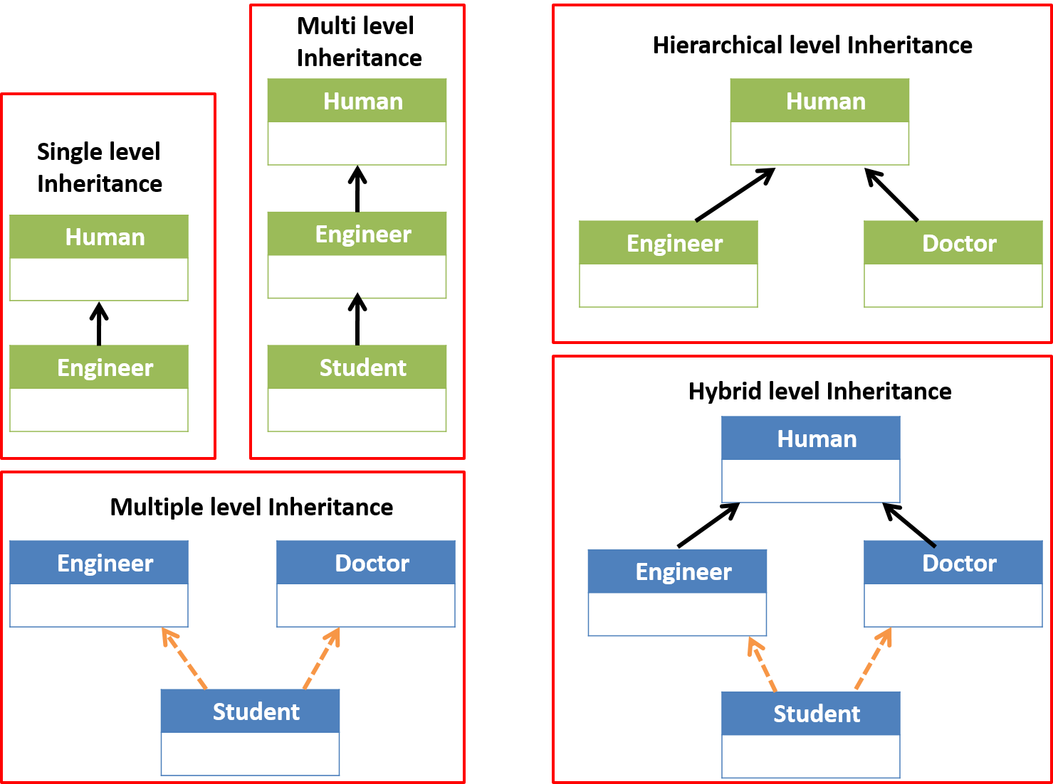
Types of Inheritance
There are five types of inheritance.
Single
Multiple
Multilevel
Hierarchical
Hybrid
Source:
https://bytesofgigabytes.com/java/inheritance-in-java
Notes:
The different types of inheritance which are supported by Java.
1. Single Inheritance: In single inheritance, subclasses inherit the features of one superclass.
2. Multilevel Inheritance: In Multilevel Inheritance, a derived class will be inheriting a base class and as well as the derived class also act as the base class to other class.
3. Hierarchical Inheritance: In Hierarchical Inheritance, one class serves as a superclass (base class) for more than one subclass.
4. Multiple Inheritance (Through Interfaces): In Multiple inheritances, one class can have more than one superclass and inherit features from all parent classes. Please note that Java does not support multiple inheritances with classes. In java, we can achieve multiple inheritances only through Interfaces.
5. Hybrid Inheritance(Through Interfaces): It is a mix of two or more of the above types of inheritance. Since java doesn’t support multiple inheritances with classes, hybrid inheritance is also not possible with classes. In java, we can achieve hybrid inheritance only through Interfaces.
References - https://www.geeksforgeeks.org/inheritance-in-java

Slide 41
Java Inheritance
Inheritance is one of the key features of OOP that allows us to create a new class from an existing class. Java does not support multiple inheritance
The extends keyword is used to perform inheritance in Java.
There are five types of inheritance:
1
2
Single Inheritance
Multilevel Inheritance
3
4
5
Hierarchical Inheritance
Multiple Inheritance
Hybrid Inheritance
Notes:
Java Inheritance
Inheritance is one of the key features of OOP that allows us to create a new class from an existing class.
The new class that is created is known as subclass (child or derived class) and the existing class from where the child class is derived is known as superclass (parent or base class).
The extends keyword is used to perform inheritance in Java.
Types of inheritance
There are five types of inheritance.
1. Single Inheritance
In single inheritance, a single subclass extends from a single superclass.
2. Multilevel Inheritance
In multilevel inheritance, a subclass extends from a superclass and then the same subclass acts as a superclass for another class.
3. Hierarchical Inheritance
In hierarchical inheritance, multiple subclasses extend from a single superclass.
4. Multiple Inheritance
In multiple inheritance, a single subclass extends from multiple superclasses.
5. Hybrid Inheritance
Hybrid inheritance is a combination of two or more types of inheritance.
Java does not support multiple inheritance
Reference - https://www.programiz.com/java-programming

Slide 42
Java Super
The super keyword in Java is used in subclasses to access superclass members (attributes, constructors and methods).
Uses of Super Keyword:
To call methods of the superclass that is overridden in the subclass.
To access attributes (fields) of the superclass if both superclass and subclass have attributes with the same name.
To explicitly call superclass no-arg (default) or parameterized constructor from the subclass constructor.
Notes:
Java super
The super keyword in Java is used in subclasses to access superclass members (attributes, constructors and methods).
Uses of super keyword
To call methods of the superclass that is overridden in the subclass.
To access attributes (fields) of the superclass if both superclass and subclass have attributes with the same name.
To explicitly call superclass no-arg (default) or parameterized constructor from the subclass constructor.
Let’s understand each of these uses.
1. Access Overridden Methods of the superclass
If methods with the same name are defined in both superclass and subclass, the method in the subclass overrides the method in the superclass.
2. Access Attributes of the Superclass
The superclass and subclass can have attributes with the same name. We use the super keyword to access the attribute of the superclass.
3. Use of super() to access superclass constructor
As we know, when an object of a class is created, its default constructor is automatically called.
To explicitly call the superclass constructor from the subclass constructor, we use super(). It's a special form of the super keyword.
super() can be used only inside the subclass constructor and must be the first statement.
Reference - https://www.programiz.com/java-programming

Slide 43
Lab 26: Inheritance in JAVA
Notes:
Let’s see how inheritance work in real-time.
*****************Trainer will explain inheritance concepts by creating classes and inheriting them. This includes single, multilevel, hierarchal and hybrid inheritance.***************

Slide 44
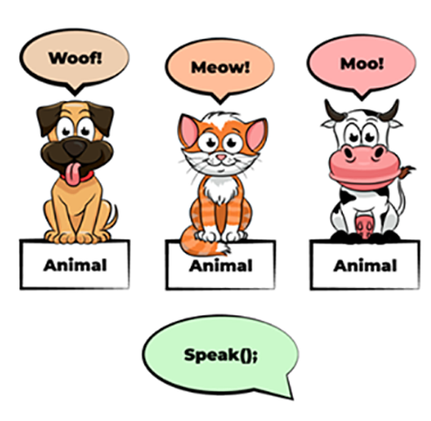
Polymorphism
Allows programmers to use the same word in Java to mean different things in different contexts.
One form of polymorphism is method overloading.
The other form is method overriding.
Source:
https://codegym.cc/groups/posts/polymorphism-in-java
Notes:
Allows programmers to use the same word in Java to mean different things in different contexts.
One form of polymorphism is method overloading.
The other form is method overriding.
Polymorphism in Java is a concept by which we can perform a single action in different ways. Polymorphism is derived from 2 Greek words: poly and morphs. The word "poly" means many and "morphs" means forms. So polymorphism means many forms.
There are two types of polymorphism in Java: compile-time polymorphism and runtime polymorphism. We can perform polymorphism in java by method overloading and method overriding.
If you overload a static method in Java, it is the example of compile time polymorphism.
References - https://www.javatpoint.com/runtime-polymorphism-in-java

Slide 45
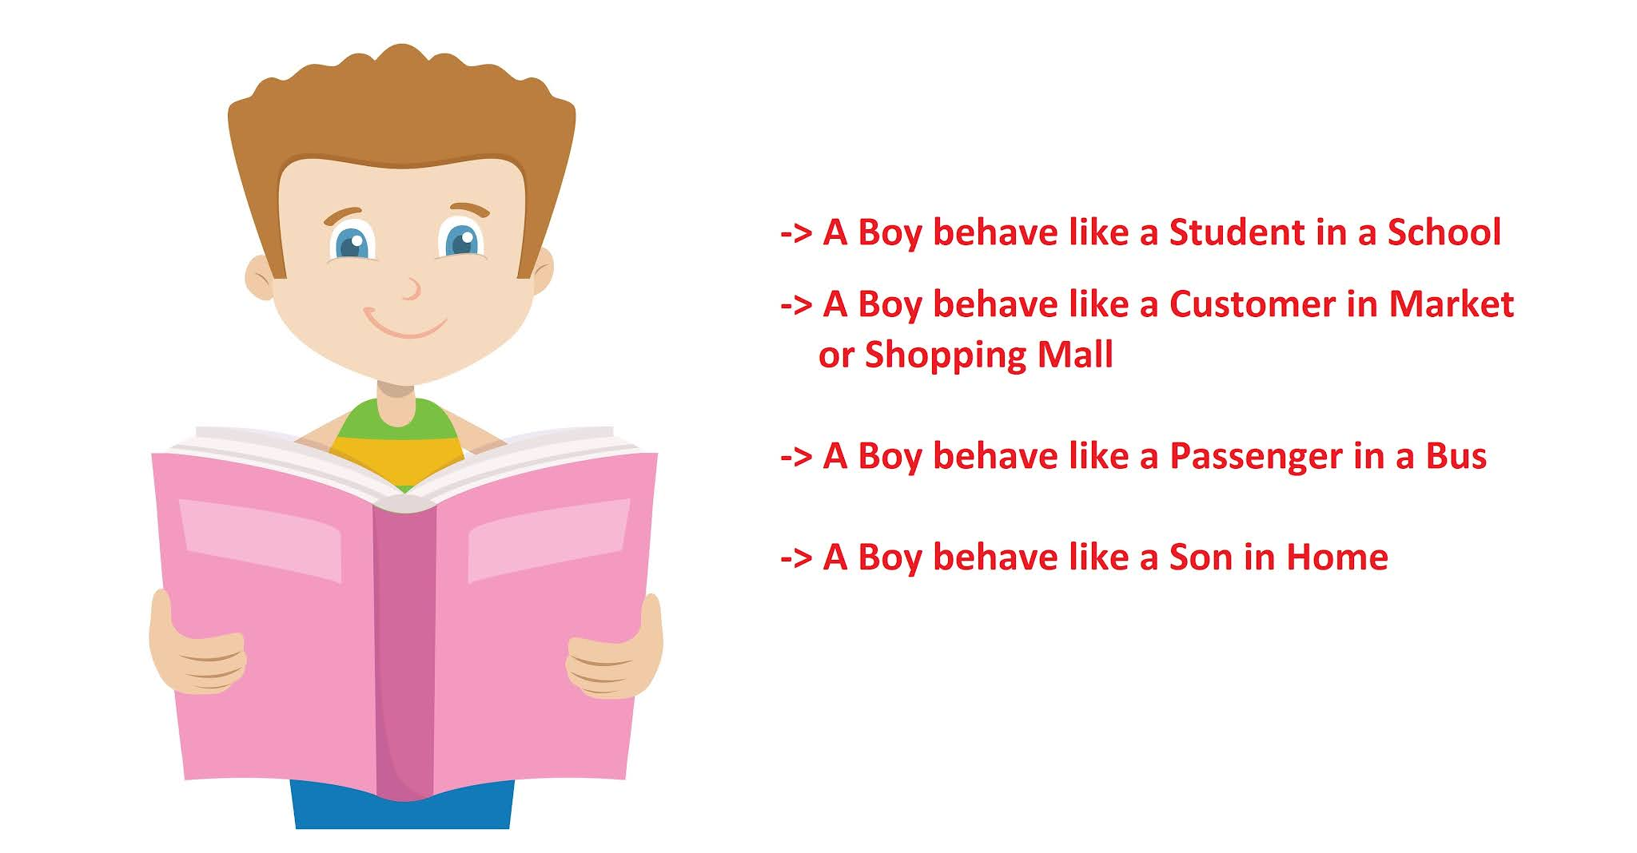
How Polymorphism Works?
We might create a class called “horse” by extending the “animal” class.
That class might also implement the “professional racing” class.
The “horse” class is “polymorphic,” since it inherits attributes of both the “animal” and “professional racing” class.
Source:
https://www.javaguides.net/2018/08/polymorphism-in-java-with-example.html
Notes:
We might create a class called “horse” by extending the “animal” class.
That class might also implement the “professional racing” class.
The “horse” class is “polymorphic,” since it inherits attributes of both the “animal” and “professional racing” class.

Slide 46
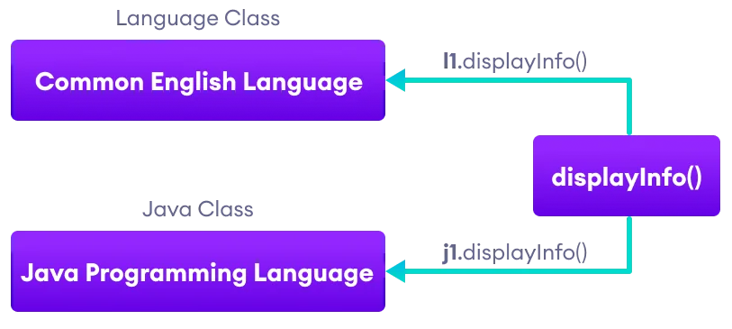
Java Polymorphism
Polymorphism is an important concept of object-oriented programming.
It simply means more than one form.
Polymorphism allows us to create consistent code.
We can achieve polymorphism in Java using the following ways:
Method Overriding
Method Overloading
Working of Java polymorphism
Source:
https://www.programiz.com/java-programming/polymorphism
Notes:
Java Polymorphism
Polymorphism is an important concept of object-oriented programming. It simply means more than one form.
That is, the same entity (method or operator or object) can perform different operations in different scenarios.
Polymorphism allows us to create consistent code.
We can achieve polymorphism in Java using the following ways:
Method Overriding
Method Overloading
The method that is called is determined during the execution of the program. Hence, method overriding is a run-time polymorphism.
The method that is called is determined by the compiler. Hence, it is also known as compile-time polymorphism.
Reference - https://www.programiz.com/java-programming

Slide 47
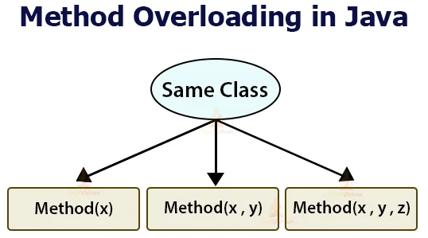
Method Overloading
A single method may perform different functions depending on the context in which it’s called.
This means a single method name might work in different ways depending on what arguments are passed to it.
Source:
https://techvidvan.com/tutorials/method-overloading-and-overriding
Notes:
A single method may perform different functions depending on the context in which it’s called.
This means a single method name might work in different ways depending on what arguments are passed to it.

Slide 48
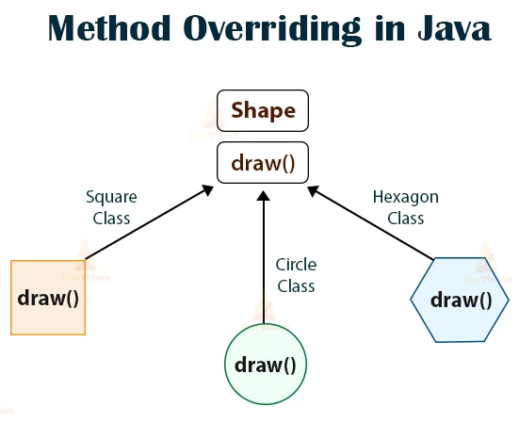
Method Overriding
The child class can override a method of its parent class.
That allows a programmer to use one method in different ways depending on whether it’s invoked by an object of the parent class or an object of the child class.
Source:
https://techvidvan.com/tutorials/method-overloading-and-overriding
Notes:
The child class can override a method of its parent class.
That allows a programmer to use one method in different ways depending on whether it’s invoked by an object of the parent class or an object of the child class.

Slide 49
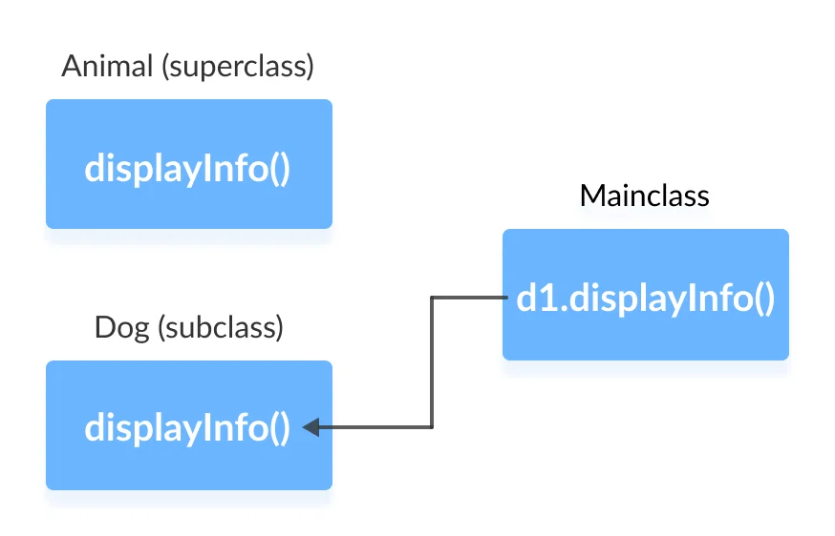
Java Method Overriding
If the same method is defined in both the superclass and the subclass, then the method of the subclass class overrides the method of the superclass.
This is known as method overriding.
Source:
https://www.programiz.com/java-programming/method-overriding
Notes:
If the same method is defined in both the superclass and the subclass, then the method of the subclass class overrides the method of the superclass. This is known as method overriding.
Reference - https://www.programiz.com/java-programming

Slide 50
Java Method Overriding
Java Overriding Rules:
Both the superclass and the subclass must have the same method name, the same return type and the same parameter list.
We cannot override the method declared as final and static.
We should always override abstract methods of the superclass
Notes:
Java Method Overriding
Here are the Java Overriding Rules:
Both the superclass and the subclass must have the same method name, the same return type and the same parameter list.
We cannot override the method declared as final and static.
We should always override abstract methods of the superclass
Reference - https://www.programiz.com/java-programming

Slide 51
Lab 27: Polymorphism in Java
Notes:
Let’s see how polymorphism works in real-time.
*****************Trainer will explain inheritance concepts by creating methods. Method overloading and method overriding should be discussed here.***************

Slide 52
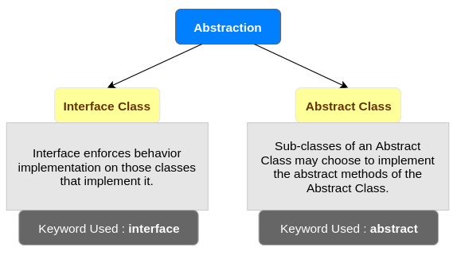
Abstraction
In Java, abstraction means simple things like objects, classes and variables represent more complex underlying code and data.
It lets you avoid repeating the same work multiple times.
Source:
https://www.tutorialkart.com/java/abstraction-in-java
Notes:
Abstraction is a process of hiding the implementation details and showing only functionality to the user.
Another way, it shows only essential things to the user and hides the internal details, for example, sending SMS where you type the text and send the message. You don't know the internal processing about the message delivery.
Abstraction lets you focus on what the object does instead of how it does it.
Ways to achieve Abstraction
There are two ways to achieve abstraction in java
Abstract class
Interface
References - https://www.javatpoint.com/abstract-class-in-java#:~:text=in%20Java%20first.-,Abstraction%20in%20Java,only%20functionality%20to%20the%20user.&text=Another%20way%2C%20it%20shows%20only,text%20and%20send%20the%20message

Slide 53
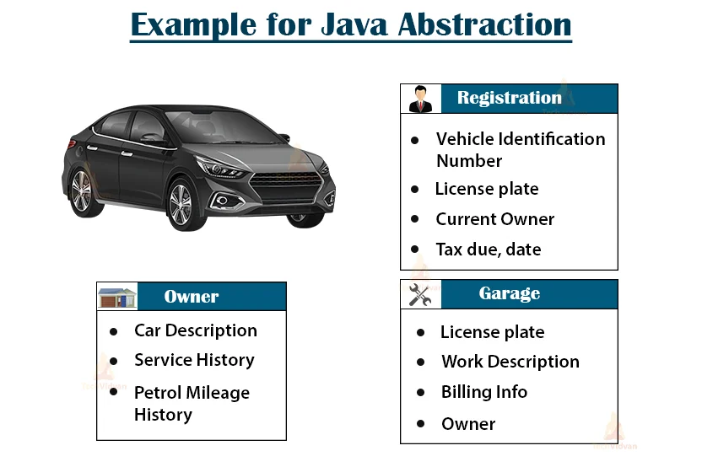
How Abstraction Works?
Abstraction lets programmers create useful and reusable tools.
For example, a programmer can create several different types of objects, which can be variables, functions or data structures. Programmers can also create different classes of objects as ways to define the objects.
Source:
https://techvidvan.com/tutorials/abstraction-in-java
Notes:
Abstraction lets programmers create useful and reusable tools.
For example, a programmer can create several different types of objects, which can be variables, functions or data structures. Programmers can also create different classes of objects as ways to define the objects.

Slide 54
Java Abstract Class
The abstract class in Java cannot be instantiated (we cannot create objects of abstract classes).
We use the abstract keyword to declare an abstract class.
An abstract class can have both the regular methods and abstract methods.
If a class contains an abstract method, then the class should be declared abstract.
An abstract class can have constructors like the regular class.
Notes:
Java Abstract Class
The abstract class in Java cannot be instantiated (we cannot create objects of abstract classes). We use the abstract keyword to declare an abstract class.
An abstract class can have both the regular methods and abstract methods.
Java Abstract Method
A method that doesn't have its body is known as an abstract method. We use the same abstract keyword to create abstract methods.
If a class contains an abstract method, then the class should be declared abstract.
Implementing Abstract Methods
If the abstract class includes any abstract method, then all the child classes inherited from the abstract superclass must provide the implementation of the abstract method.
Accesses Constructor of Abstract Classes
An abstract class can have constructors like the regular class. And, we can access the constructor of an abstract class from the subclass using the super keyword.
Reference - https://www.programiz.com/java-programming

Slide 55
Java Interface
An interface is a fully abstract class. It includes a group of abstract methods .
We use the interface keyword to create an interface in Java.
Like abstract classes, we cannot create objects of interfaces.
To use an interface, other classes must implement it.
We use the implements keyword to implement an interface.
In Java, a class can also implement multiple interfaces.
Similar to classes, interfaces can extend other interfaces.
Notes:
Java Interface
An interface is a fully abstract class. It includes a group of abstract methods (methods without a body).
We use the interface keyword to create an interface in Java.
Implementing an Interface
Like abstract classes, we cannot create objects of interfaces.
To use an interface, other classes must implement it. We use the implements keyword to implement an interface.
Implementing Multiple Interfaces
In Java, a class can also implement multiple interfaces.
Extending an Interface
Similar to classes, interfaces can extend other interfaces. The extends keyword is used for extending interfaces.
Extending Multiple Interfaces
An interface can extend multiple interfaces.
Advantages of Interface in Java
Similar to abstract classes, interfaces help us to achieve abstraction in Java.
Interfaces provide specifications that a class (which implements it) must follow.
Interfaces are also used to achieve multiple inheritance in Java.
Reference - https://www.programiz.com/java-programming

Slide 56
Lab 28: Abstraction in Java
Notes:
Let’s see how abstraction work in real-time.
*****************Trainer will explain inheritance concepts by creating abstract classes and interfaces.***************

Slide 57
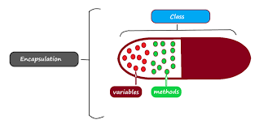
Encapsulation
Encapsulation is a protective barrier that keeps the data and code safe within the class itself.
We can then reuse objects like code components or variables without allowing open access to the data system-wide.
Source:
https://techblogstation.com/java/oops-concepts-in-java
Notes:
Encapsulation is a protective barrier that keeps the data and code safe within the class itself.
We can then reuse objects like code components or variables without allowing open access to the data system-wide.

Slide 58
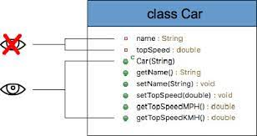
How Encapsulation Works?
Encapsulation lets us reuse functionality without compromising security.
It’s a powerful, time-saving OOP concept in Java.
For example, we may create a piece of code that calls specific data from a database.
Source:
https://javatutorial.net/java-encapsulation-example
Notes:
Encapsulation lets us reuse functionality without compromising security.
It’s a powerful, time-saving OOP concept in Java.
For example, we may create a piece of code that calls specific data from a database.

Slide 59
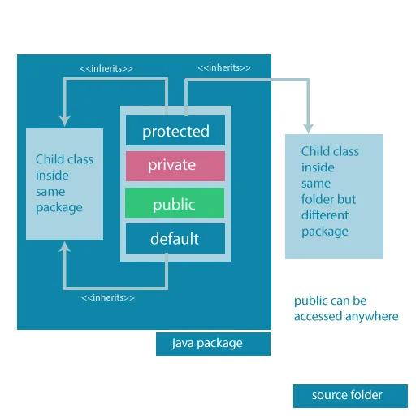
Java Access Modifiers
In Java, access modifiers are used to set the accessibility (visibility) of classes, interfaces, variables, methods, constructors, data members, and the setter methods.
There are four access modifiers keywords in Java:
Default
Private
Protected
Public
Accessibilty of all access modifiers in java
Source:
https://www.programiz.com/java-programming/access-modifiers
Notes:
What are Access Modifiers?
In Java, access modifiers are used to set the accessibility (visibility) of classes, interfaces, variables, methods, constructors, data members, and the setter methods.
There are four access modifiers keywords in Java:
Default
Private
Protected
Public
Default Access Modifier
If we do not explicitly specify any access modifier for classes, methods, variables, etc, then by default the default access modifier is considered.
Private Access Modifier
When variables and methods are declared private, they cannot be accessed outside of the class.
Protected Access Modifier
When methods and data members are declared protected, we can access them within the same package as well as from subclasses.
Public Access Modifier
When methods, variables, classes, and so on are declared public, then we can access them from anywhere. The public access modifier has no scope restriction.
Reference - https://www.programiz.com/java-programming

Slide 60
Lab 29: Encapsulation in Java
Notes:
Let’s see how encapsulation can be used in action.
*****************Trainer will explain access modifiers in Java programs.***************

Slide 61
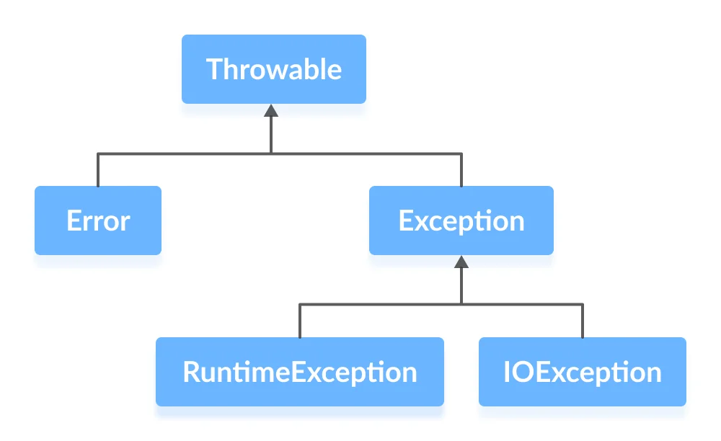
Java Exceptions
An exception is an unexpected event that occurs during program execution.
Errors
Errors represent irrecoverable conditions
Errors are usually beyond the control of the programmer, and we should not try to handle errors.
Exceptions
Exceptions can be caught and handled by the program.
Java Exception Hierarchy
Image source:
Source:
https://www.programiz.com/java-programming/exceptions
Notes:
Java Exceptions
An exception is an unexpected event that occurs during program execution. It affects the flow of the program instructions which can cause the program to terminate abnormally.
An exception can occur for many reasons. Some of them are:
Invalid user input
Device failure
Loss of network connection
Physical limitations (out of disk memory)
Code errors
Opening an unavailable file
Java Exception hierarchy
Here is a simplified diagram of the exception hierarchy in Java. The Throwable class is the root class in the hierarchy.
The hierarchy splits into two branches: Error and Exception.
Errors
Errors represent irrecoverable conditions such as Java virtual machine (JVM) running out of memory, memory leaks, stack overflow errors, library incompatibility, infinite recursion, etc.
Errors are usually beyond the control of the programmer and we should not try to handle errors.
Exceptions
Exceptions can be caught and handled by the program.
When an exception occurs within a method, it creates an object. This object is called the exception object.
It contains information about the exception such as the name and description of the exception and state of the program when the exception occurred.
Reference - https://www.programiz.com/java-programming

Slide 62
Java try...catch
The try...catch block in Java is used to handle exceptions and prevents the abnormal termination of the program.
The try block includes the code that might generate an exception.
The catch block includes the code that is executed when there occurs an exception inside the try block.
In Java, we can use a try block without a catch block. However, we cannot use a catch block without a try block.
Notes:
Java try...catch
The try...catch block in Java is used to handle exceptions and prevents the abnormal termination of the program.
The try block includes the code that might generate an exception.
The catch block includes the code that is executed when there occurs an exception inside the try block.
In Java, we can use a try block without a catch block. However, we cannot use a catch block without a try block.
Reference - https://www.programiz.com/java-programming

Slide 63
Multiple Catch Blocks
For each try block, there can be zero or more catch blocks.
Multiple catch blocks allow us to handle each exception differently.
The argument type of each catch block indicates the type of exception that can be handled by it.
Notes:
Multiple Catch blocks
For each try block, there can be zero or more catch blocks.
Multiple catch blocks allow us to handle each exception differently.
The argument type of each catch block indicates the type of exception that can be handled by it.
Reference - https://www.programiz.com/java-programming

Slide 64
Finally Block
The finally block is always executed whether there is an exception inside the try block or not.
The code inside the finally block is executed irrespective of the exception.
It is a good practice to use finally block to include important cleanup code like closing a file or connection.
Notes:
Finally block
The finally block is always executed whether there is an exception inside the try block or not.
The code inside the finally block is executed irrespective of the exception.
It is a good practice to use finally block to include important cleanup code like closing a file or connection.
Reference - https://www.programiz.com/java-programming

Slide 65
Java throw and throws
Java throws keyword
The throws keyword in the method declaration to declare the type of exceptions that might occur within it.
Java throw keyword
The throw keyword is used to explicitly throw a single exception.
Notes:
In Java, exceptions can be categorized into two types:
Unchecked Exceptions: They are not checked at compile-time but at run-time.For example: ArithmeticException, NullPointerException, ArrayIndexOutOfBoundsException, exceptions under Error class, etc.
Checked Exceptions: They are checked at compile-time. For example, IOException, InterruptedException, etc.
Usually, we don't need to handle unchecked exceptions.
It's because unchecked exceptions occur due to programming errors. And, it is a good practice to correct them instead of handling them.
Java throws keyword
We use the throws keyword in the method declaration to declare the type of exceptions that might occur within it.
If a method does not handle exceptions, the type of exceptions that may occur within it must be specified in the throws clause so that methods further up in the call stack can handle them or specify them using throws keyword themselves.
Java throw keyword
The throw keyword is used to explicitly throw a single exception.
When an exception is thrown, the flow of program execution transfers from the try block to the catch block.
We use the throw keyword within a method.
A throwable object is an instance of class Throwable or subclass of the Throwable class.
Reference - https://www.programiz.com/java-programming

Slide 66
Lab 30: Exception Handling in Java
Notes:
Exception handling helps us to be ready for any unintended event. Let’s try exception handling in a java program.
**************Trainers demonstrate exception handling in at least 2 scenarios**************

Slide 67
Java Scanner Class
The Scanner class of the java.util package is used to read input data from different sources like input streams, users, files, etc.
The Scanner class provides various methods that allow us to read inputs of different types.
Examples are nextInt(), nextFloat(), nextBoolean(), nextLine(), etc.
Notes:
Java Scanner Class
The Scanner class of the java.util package is used to read input data from different sources like input streams, users, files, etc.
The Scanner class provides various methods that allow us to read inputs of different types.
Examples are nextInt(), nextFloat(), nextBoolean(), nextLine(), etc.
Reference - https://www.programiz.com/java-programming

Slide 68
Java Wrapper Class
The wrapper classes in Java are used to convert primitive types (int, char, float, etc) into corresponding objects.
Each of the 8 primitive types has corresponding wrapper classes.
In Java, sometimes we might need to use objects instead of primitive data types. For example, while working with collections. In such cases, wrapper classes help us to use primitive data types as objects.
We can store the null value in wrapper objects.
Notes:
Java Wrapper Class
The wrapper classes in Java are used to convert primitive types (int, char, float, etc) into corresponding objects.
Each of the 8 primitive types has corresponding wrapper classes.
Primitive Type Wrapper Class
byte Byte
boolean Boolean
char Character
double Double
float Float
int Integer
long Long
short Short
In Java, sometimes we might need to use objects instead of primitive data types. For example, while working with collections. In such cases, wrapper classes help us to use primitive data types as objects.
We can store the null value in wrapper objects.
Reference - https://www.programiz.com/java-programming

Slide 69
Java Type Casting
The process of converting the value of one data type (int, float, double, etc.) to another data type is known as typecasting.
In Widening Type Casting, Java automatically converts one data type to another data type.
The lower data type (having smaller size) is converted into the higher data type (having larger size). Hence there is no loss in data.
We manually convert one data type into another using the parenthesis.
This is also known as Explicit Type Casting.
Notes:
Java Type Casting
The process of converting the value of one data type (int, float, double, etc.) to another data type is known as typecasting.
Widening Type Casting
In Widening Type Casting, Java automatically converts one data type to another data type.
The lower data type (having smaller size) is converted into the higher data type (having larger size). Hence there is no loss in data.
Narrowing Type Casting
We manually convert one data type into another using the parenthesis.
This is also known as Explicit Type Casting.
Reference - https://www.programiz.com/java-programming

Slide 70
Java Command-Line Arguments
The command-line arguments in Java allow us to pass arguments during the execution of the program.
public static void main(String[] args) {...}
The String array stores all the arguments passed through the command line.
Notes:
Java Command-Line Arguments
The command-line arguments in Java allow us to pass arguments during the execution of the program.
As the name suggests arguments are passed through the command line.
public static void main(String[] args) {...}
The String array stores all the arguments passed through the command line.
Arguments are always stored as strings and always separated by white-space.
Reference - https://www.programiz.com/java-programming

Slide 71
Lab 31: Taking User Inputs in Java
Notes:
Now that we have understood scanner classes and Command line arguments. Let’s use these concepts to take inputs from user.
******************Trainer will demonstrate how to take user inputs in different ways***********

Slide 72
Java Database Connectivity with MySQL
To connect Java application with the MySQL database, we need to follow 5 following steps.
Driver class: The driver class for the mysql database is com.mysql.jdbc.Driver.
Connection URL: The connection URL for the mysql database is jdbc:mysql://localhost:3306/aziz where jdbc is the API, mysql is the database, localhost is the server name on which mysql is running, we may also use IP address, 3306 is the port number and aziz is the database name. We may use any database, in such case, we need to replace the aziz with our database name.
Username: The default username for the mysql database is root.
Password: It is the password given by the user at the time of installing the mysql database. In this example, we are going to use root as the password.
Notes:
To connect Java application with the MySQL database, we need to follow 5 following steps.
Driver class: The driver class for the mysql database is com.mysql.jdbc.Driver.
Connection URL: The connection URL for the mysql database is jdbc:mysql://localhost:3306/aziz where jdbc is the API, mysql is the database, localhost is the server name on which mysql is running, we may also use IP address, 3306 is the port number and aziz is the database name. We may use any database, in such case, we need to replace the aziz with our database name.
Username: The default username for the mysql database is root.
Password: It is the password given by the user at the time of installing the mysql database. In this example, we are going to use root as the password.

Slide 73
Lab 32: Database Connectivity in Java
Notes:
Let’s connect database to a java program.
**************trainer will explain how to use MySQL credentials in java scripts******************

Slide 74
Java Database Connectivity with MySQL
Let's first create a table in the mysql database, but before creating table, we need to create database first.
create database aziz;
use aziz;
create table emp(id int(10),name varchar(40),age int(3));
Notes:
Let's first create a table in the mysql database, but before creating table, we need to create database first.
We will use the names of database and the table to establish connection and query to the database from Java.
create database aziz;
use aziz;
create table emp(id int(10),name varchar(40),age int(3));

Slide 75
Example to Connect Java Application with Mysql Database
In this example, aziz is the database name, root is the username and password both.
import java.sql.*;
class MysqlCon{
public static void main(String args[]){
try{
Class.forName("com.mysql.jdbc.Driver");
Connection con=DriverManager.getConnection( "jdbc:mysql://localhost:3306/aziz","root","root");
//here aziz is database name, root is username and password
Statement stmt=con.createStatement();
ResultSet rs=stmt.executeQuery("select * from emp");
while(rs.next())
System.out.println(rs.getInt(1)+" "+rs.getString(2)+" "+rs.getString(3));
con.close();
}catch(Exception e){ System.out.println(e);}
}
}
Notes:
You can use the code displayed on the screen to connect a java program to a database.
Here, the name of database is Aziz and the username, password is root.
You can set your own username, password or database name in your implementation.

Slide 76

Summary
Java is an Object-Oriented Programming Language.
Java is used for building a wide range of software applications, from web and mobile apps to desktop programs and server systems.
Java can be integrated with different database management system software too.
Notes:
Summary
Java is an Object-Oriented Programming Language.
Java is used for building a wide range of software applications, from web and mobile apps to desktop programs and server systems.
Java can be integrated with different database management system software too.

Slide 77

Quiz
1. What is Java primarily known for?
Database management
Graphic design
Cross-platform programming
Video editing
Answer: c
Cross-platform programming

Slide 78
Quiz
2. Which of the following is NOT a primitive data type in Java?
int
float
string
char
Answer: c
string

Slide 79
Quiz
3. What is the process of combining data and functions into a single unit called in Java?
Inheritance
Encapsulation
Polymorphism
Abstraction
Answer: b
Encapsulation

Slide 80
Quiz
4. Which keyword is used to create a new instance of a class in Java?
object
instance
new
create
Answer: c
new

Slide 81
Thank you!
Notes:
81

